Slide 1

INSTITUTE - UIE
DEPARTMENT- ACADEMIC UNIT-2
Bachelor of Engineering (Computer Science & Engineering)
Subject Name: Object Oriented Programming using C++
Subject Code:20CST151
Unit-2
Inheritance
DISCOVER . LEARN . EMPOWER

Slide 2


Object Oriented Programming using C++
Course Objectives
To enable the students to understand various stages and constructs of C++ programming language and relate them to engineering programming problems.
To improve their ability to analyze and address variety of problems in programming domains.

Slide 3



Course Outcomes
CO Number | Title | Level
CO1 | Provide the environment that allows students to understand object-oriented programming Concepts | Understand
CO2 | Demonstrate basic experimental skills for differentiating between object-oriented and procedural programming paradigms and the advantages of object-oriented programs. | Remember
CO3 | Demonstrate their coding skill on complex programming concepts and use it for generating solutions for engineering and mathematical problems. | Understand
CO4 | Develop skills to understand the application of classes, objects, constructors, destructors, inheritance, operator overloading and polymorphism, pointers, virtual functions, exception handling, file operations and handling. | Understand

Slide 4
Scheme of Evaluation
Sr. No. | Type of Assessment Task | Weightage of actual conduct | Frequency of Task | Final Weightage in Internal Assessment (Prorated Marks) | Remarks
1. | Assignment* | 10 marks of each assignment | One Per Unit | 10 marks | As applicable to course types depicted above.
2. | Time Bound Surprise Test | 12 marks for each test | One per Unit | 4 marks | As applicable to course types depicted above.
3. | Quiz | 4 marks of each quiz | 2 per Unit | 4marks | As applicable to course types depicted above.
4. | Mid-Semester Test** | 20 marks for one MST. | 2 per semester | 20 marks | As applicable to course types depicted above.
5. | Presentation*** |  |  | Non Graded: Engagement Task | Only for Self Study MNGCourses.
6. | Homework | NA | One per lecture topic (of 2 questions) | Non-Graded: Engagement Task | As applicable to course types depicted above.
7. | Discussion Forum | NA | One per Chapter | Non Graded: Engagement Task | As applicable to course types depicted above.
8. | Attendance and Engagement Score on BB | NA | NA | 2 marks

Slide 5
CONTENTS
Defining derived class,
modes of inheritance,
types of inheritance,
ambiguity in inheritance,
virtual base class,
Function overriding,
Member Classes: Nesting of Classes.
The capability of a class to derive properties and characteristics from another class is called Inheritance.
Inheritance is one of the most important feature of Object Oriented Programming

Slide 6
INHERITANCE
It is the Process of creating a New class from an existing class. The Existing class is called Base or Parent class. The New class is called as Child or Derived Class.
Advantages
It permits code reusability. So, save time and increase the program reliability.
A programmer can use a class created by another person or company without modifying it derive other classes from it that are suited to particular situations
Improve Program Reliability
It Permits code sharing
It permits code reusability. So, save time and increase the program reliability.
A programmer can use a class created by another person or company without modifying it derive other classes from it that are suited to particular situations
Improve Program Reliability
It Permits code sharing
The base class need not be changed but can be adapted to suit the requirements in different applications.

Slide 7
INHERITANCE
It is the Process of creating a New class from an existing class. The Existing class is called Base or Parent class. The New class is called as Child or Derived Class.
Base/Sub Class
Derived/Super class
Methods and Properties
Base class methods + Additional methods

Slide 8
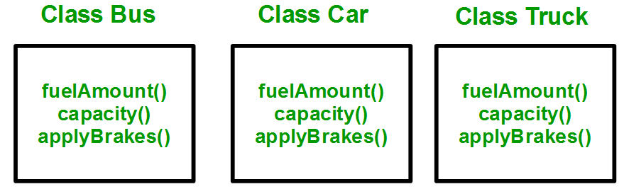
WHY AND WHEN TO USE INHERITANCE?
Consider a group of vehicles. You need to create classes for Bus, Car and Truck. The methods fuelAmount(), capacity(), applyBrakes() will be same for all of the three classes. If we create these classes avoiding inheritance then we have to write all of these functions in each of the three classes as shown in below figure:
Figure 4.1 Need of inheritance [1]

Slide 9
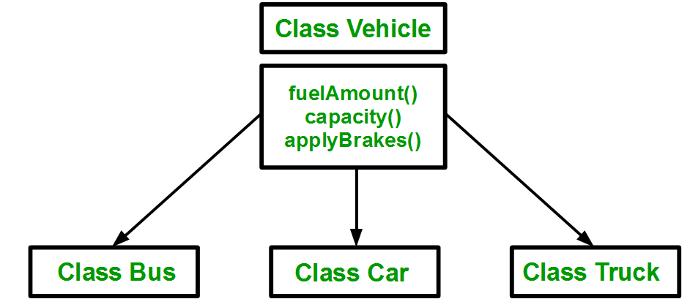
WHY AND WHEN TO USE INHERITANCE?
If we create a class Vehicle and write these three functions in it and inherit the rest of the classes from the vehicle class, then we can simply avoid the duplication of data and increase re-usability
Figure 4.2 Need of inheritance [1]

Slide 10
IMPLEMENTING INHERITANCE IN C++
For creating a sub-class which is inherited from the base class we have to follow the below syntax.
Syntax:
class subclass_name : access_mode base_class_name
{
//body of subclass
};
Here, subclass_name is the name of the sub class, access_mode is the mode in which you want to inherit this sub class for example: public, private etc. and base_class_name is the name of the base class from which you want to inherit the sub class.

Slide 11
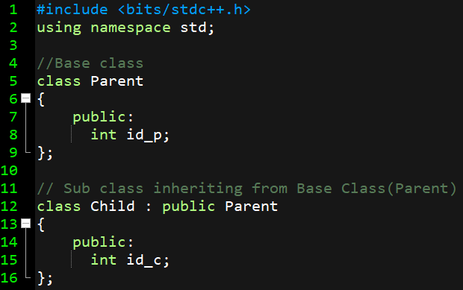
IMPLEMENTING INHERITANCE IN C++
EXAMPLE
Figure 4.3 Example inheritance made on Dev C++

Slide 12
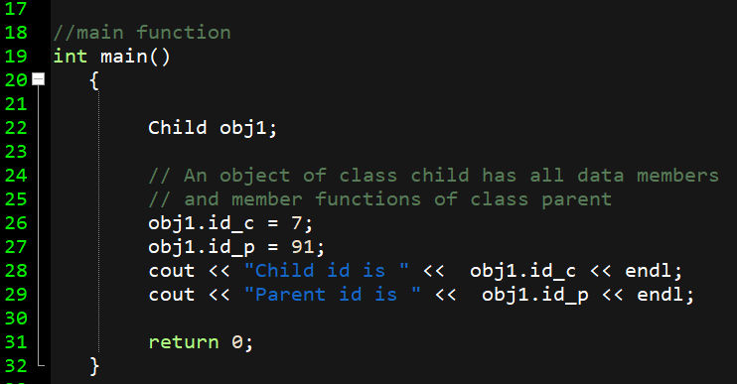
IMPLEMENTING INHERITANCE IN C++
EXAMPLE
Figure 4.4 Example inheritance made on Dev C++
Notes:
#include <bits/stdc++.h>
using namespace std;
//Base class
class Parent
{
public:
int id_p;
};
// Sub class inheriting from Base Class(Parent)
class Child : public Parent
{
public:
int id_c;
};
//main function
int main()
{
Child obj1;
// An object of class child has all data members
// and member functions of class parent
obj1.id_c = 7;
obj1.id_p = 91;
cout << "Child id is " << obj1.id_c << endl;
cout << "Parent id is " << obj1.id_p << endl;
return 0;
}

Slide 13
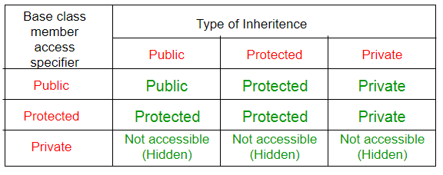
MODES OF INHERITANCE
Modes of Inheritance
Public mode: If we derive a sub class from a public base class. Then the public member of the base class will become public in the derived class and protected members of the base class will become protected in derived class.
Protected mode: If we derive a sub class from a Protected base class. Then both public member and protected members of the base class will become protected in derived class.
Private mode: If we derive a sub class from a Private base class. Then both public member and protected members of the base class will become Private in derived class.
Figure 4.5 Modes of inheritance[1]

Slide 14
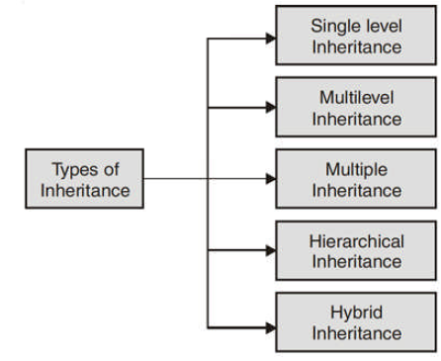
Types of Inheritance (Overview)

Slide 15
Pre-requisites (Public, Private and Protected Inheritance)
1. Public Inheritance
Consider the dummy code given below for inheritance.
class B : public A
{
}:
The line class B : public A tells the compiler that we are inheriting class A in class B in public followings :
(a) All the public members of class A becomes public members of class B.
(b) All the protected members of class A becomes protected members of class B.
(c) Private members are never inherited.

Slide 16
2. Private Inheritance
Consider the dummy code given below for inheritance:
class B : private A
{
}:
The line class B : private A tells the compiler that we are inheriting class A in class B in private mode. In private mode inheritance note the following points:
(a) All the public members of class A becomes private members of the class B.
(b) All the protected members of the class A becomes private members of class B.
(c) Private members are never inherited.

Slide 17
The above dummy code can be written as too.
class B : A
{
}:
As the default inheritance mode is private mode.

Slide 18
Protected Inheritance
Consider the dummy code given below for inheritance:
class B : protected A
{
}:
The line class B : protected A tells the compiler that we are inheriting class A in class B in protected mode. In protected mode inheritance note the following points:
(a) All the public members of class A becomes protected members of class B.
(b) All the protected members of class A becomes protected members of class B.
(c) Private members are never inherited.

Slide 19
NOTE:
Note that: A class A is inherited in class B in public mode, all protected members of class A becomes protected for class B. Now if this class B is inherited to some new class C, then these protected members inherited from A will be available from A will be available to class C, in whatever mode you inherit class B to class C.
Initially let us assume that you inherited class A into class B in private mode, then all protected members of class A becomes private for class B. They can be used inside the class B. But if you inherit class B into new class C then these members won’t be available in C as private members are never inherited.

Slide 20
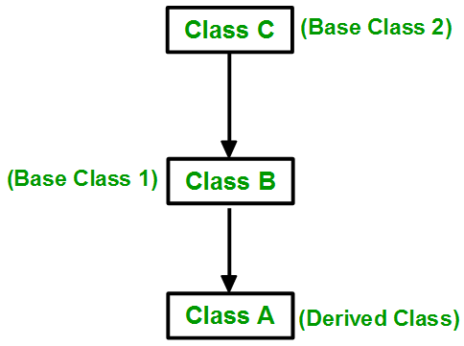
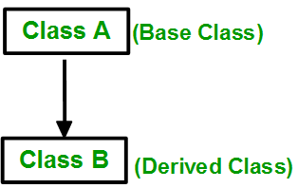
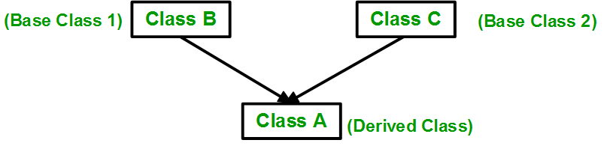
TYPES OF INHERITANCE
1. SINGLE INHERITANCE
3. MULTI-LEVEL INHERITANCE
2. MULTIPLE INHERITANCE
Figure 4.6 Types of inheritance[1]

Slide 21
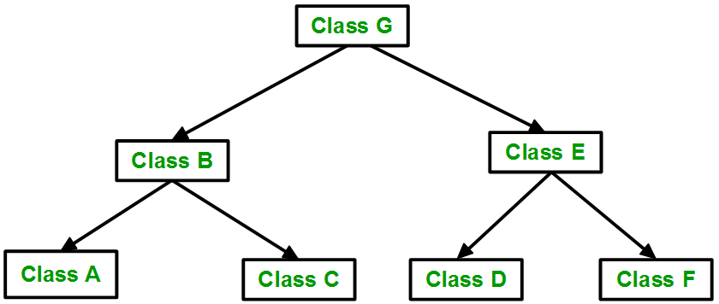
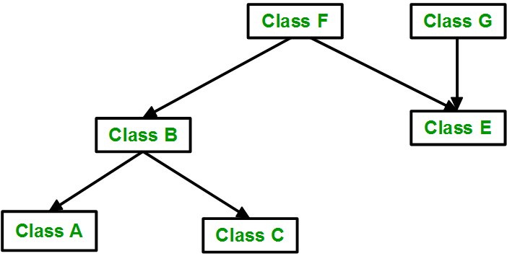
TYPES OF INHERITANCE
5. HYBRID/VIRTUAL INHERITANCE
4. HIERARCHICAL INHERITANCE
Figure 4.7 Types of inheritance[1]

Slide 22
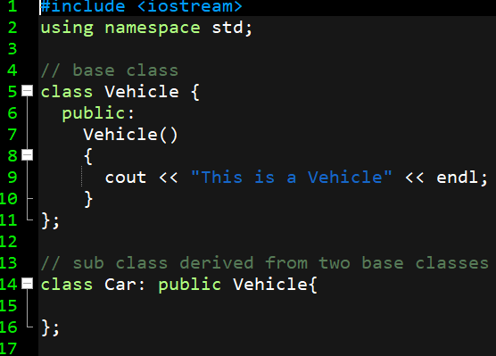
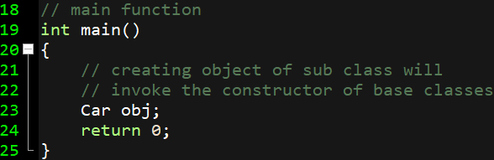
SINGLE INHERITANCE
CLASS
Figure 4.8 Program made on Dev-C++
Notes:
// C++ program to explain
// Single inheritance
#include <iostream>
using namespace std;
// base class
class Vehicle {
public:
Vehicle()
{
cout << "This is a Vehicle" << endl;
}
};
// sub class derived from two base classes
class Car: public Vehicle{
};
// main function
int main()
{
// creating object of sub class will
// invoke the constructor of base classes
Car obj;
return 0;
}

Slide 23
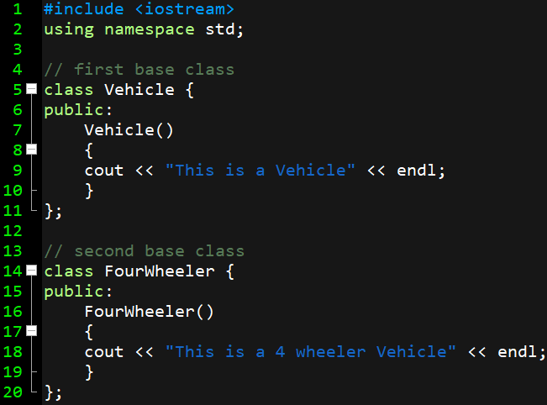
MULTIPLE INHERITANCE
CLASS
Figure 4.8 Program made on Dev-C++
Notes:
// C++ program to explain
// Single inheritance
#include <iostream>
using namespace std;
// base class
class Vehicle {
public:
Vehicle()
{
cout << "This is a Vehicle" << endl;
}
};
// sub class derived from two base classes
class Car: public Vehicle{
};
// main function
int main()
{
// creating object of sub class will
// invoke the constructor of base classes
Car obj;
return 0;
}

Slide 24
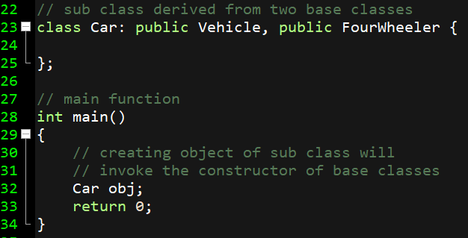
MULTIPLE INHERITANCE
CLASS
Figure 4.8 Program made on Dev-C++
Notes:
// C++ program to explain
// Single inheritance
#include <iostream>
using namespace std;
// base class
class Vehicle {
public:
Vehicle()
{
cout << "This is a Vehicle" << endl;
}
};
// sub class derived from two base classes
class Car: public Vehicle{
};
// main function
int main()
{
// creating object of sub class will
// invoke the constructor of base classes
Car obj;
return 0;
}

Slide 25
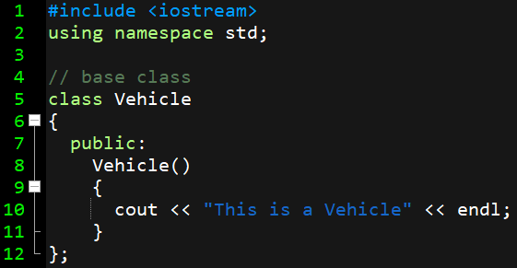
MULTILEVEL INHERITANCE
Figure 4.9 Program made on Dev-C++

Slide 26
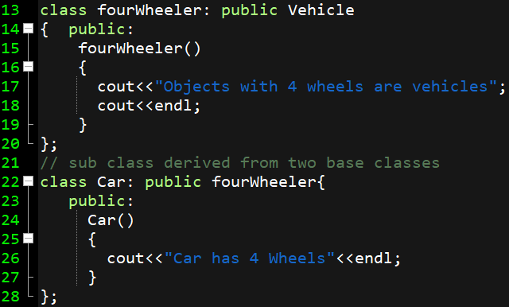
MULTILEVEL INHERITANCE
Figure 4.10 Program made on Dev-C++

Slide 27
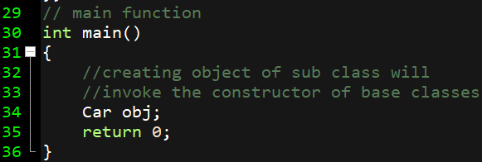
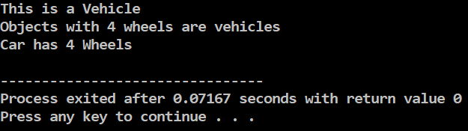
MULTILEVEL INHERITANCE
Figure 4.10 Program made on Dev-C++

Slide 28
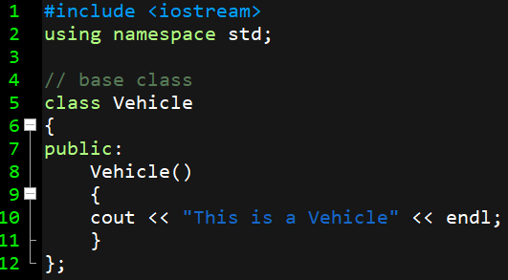
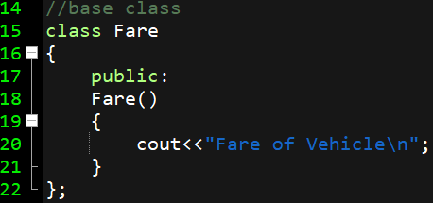
HYBRID INHERITANCE
Figure 4.14 Program made on Dev-C++
Notes:
#include <iostream>
using namespace std;
// base class
class Vehicle
{
public:
Vehicle()
{
cout << "This is a Vehicle" << endl;
}
};
//base class
class Fare
{
public:
Fare()
{
cout<<"Fare of Vehicle\n";
}
};
// first sub class
class Car: public Vehicle
{
};
// second sub class
class Bus: public Vehicle, public Fare
{
};
// main function
int main()
{
// creating object of sub class will
// invoke the constructor of base class
Bus obj2;
return 0;
}

Slide 29
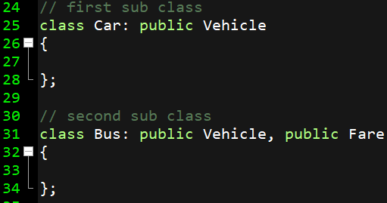
HYBRID INHERITANCE
Figure 4.15 Program made on Dev-C++

Slide 30
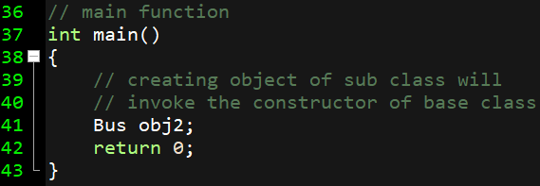
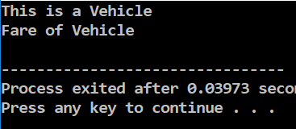
HYBRID INHERITANCE
Figure 4.16 Program made on Dev-C++

Slide 31
Assessment Questions
(a) Define ambiguity in inheritance.
(b) What are modes of inheritance?
(c) What is nesting of classes?
Can we call private constructor? If yes , then how?
Write a C++ program to differentiate between three modes of inheritance.
Write a C++ program to demonstrate hierarchical inheritance.

Slide 32
APPLICATIONS
You use nested classes to reflect and to enforce the relationship between two classes. You should define a class within another class when the nested class makes sense only in the context of its enclosing class or when it relies on the enclosing class for its function. For example, a text cursor might make sense only in the context of a text component.

Slide 33
Frequently Asked Questions: -
Is inheritance important to C++?
When would I use inheritance?
How do you express inheritance in C++?
Is it okay to convert a pointer from a derived class to its base class?
What’s the difference between public, private, and protected?
Why can’t my derived class access private things from my base class?
How can I protect derived classes from breaking when I change the internal parts of the base class?
I’ve been told to never use protected data, and instead to always use private data with protected access functions. Is that a good rule?
Okay, so exactly how should I decide whether to build a “protected interface”?

Slide 34
SUMMARY
Inheritance is the mechanism of deriving new class from an existing class. The old class and new class is known as in pair : super-sub, base-derived, parent-child.
Inheritance provides the idea of reusability. Code once written can be used again and again in several different classes.
C++ provides support for: single level and multilevel inheritance, multiple inheritance, hierarchical inheritance, hybrid inheritance.
Private members are never inherited.
Virtual base class is used to avoid duplicity of data members into the target derived class.

Slide 35
SUMMARY (Continued)
In an inheritance hierarchy constructor of base class is called first, then constructor of derived class is called.
In an inheritance hierarchy destructor class is called first, then destructor of base class is called.
Containership allows us to use object of one class as a member of other class. This type of containership provides the idea of has a relationship or nesting of classes.

Slide 36

REFERENCES
Reference Website
[1] https://www.geeksforgeeks.org/inheritance-in-c/
[2] https://www.geeksforgeeks.org/object-oriented-programming-in-cpp/
[3] https://www.geeksforgeeks.org/copy-constructor-argument-const/
[4] https://en.cppreference.com/w/cpp/language/nested_types
References on YouTubes
[1] https://www.youtube.com/watch?v=rr7HVs4d1Qo
[2] https://www.youtube.com/watch?v=5pJyKzON8Ww
[3] https://www.youtube.com/watch?v=RO1ZYW9NAzg
References books
[1] Object-Oriented Programming in C++, by Robert Lafore
[2] Object-Oriented Programming Using C++, by Joyce Farrell
[3] Object-Oriented Programming Using C++, by Pohl

Slide 37
THANK YOU

